Slide 1




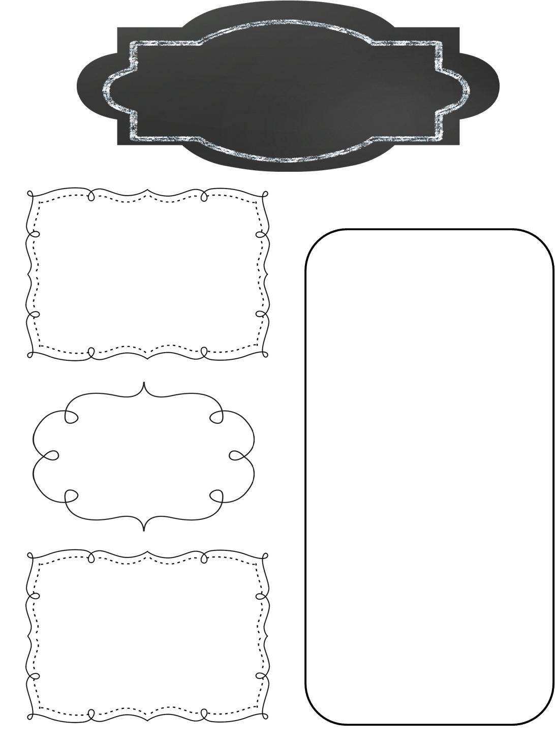




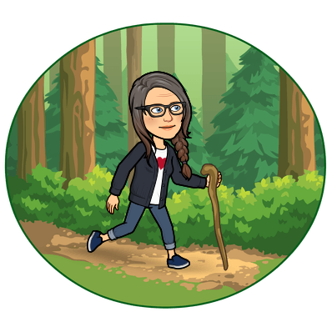
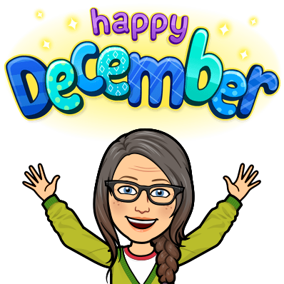
A Peek at Next Week in…
Mrs. Miller’s Class
December 2-6, 2024
What We’re Reading!
Weekly Focus
Harlem Renaissance
Genre: Informational
‘The Dream Keeper’
‘My People’
‘Words Like Freedom’
Genre: Poetry
Math
Chapter 7: Round and Estimate Numbers
Chapter 8:
Add and Subtract Multi-Digit Numbers
Assessments:
Mid Year i-Ready Math Begins December 2
Chapter 7 Quiz: Tuesday, December 3
Reading
Homework!
A Changing Nation
Unit 3 Lesson 2
Assessments:
Mid Year i-Ready Reading Begins December 2
Mid Year DIBELS Testing Friday, December 6
Homework is always
optional, but worth the time!
Homework Menu
Shared on Parent HUB, Website
Seesaw, and in Clever
Class Points earned for every
homework task completed!
Phonics & Word Meaning
95% Phonics Lesson 14:
Open Simple Multi-Syllable
Affixes and Latin Roots:
pro-/pre-; sist/stat/stunt/stand
Assessments:
Weekly Spelling Assessment
Important Dates
Cathedral Caverns Field Trip!
Wednesday, December 4
Permission slips will be sent home on Tuesday..
Please have them returned with $20 fee by MONDAY!
DECEMBER IS FULL!
Be sure to check the
Dates to Remember in
December Calendar!
Figurative Language
Narrative Writing
Grammar: Coordinating and
Subordinating Conjunctions
Writer’s Workshop

Slide 2

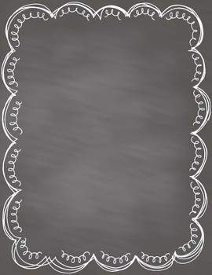

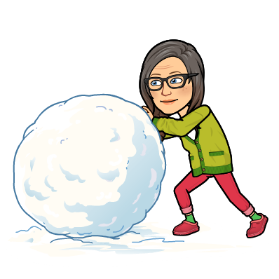
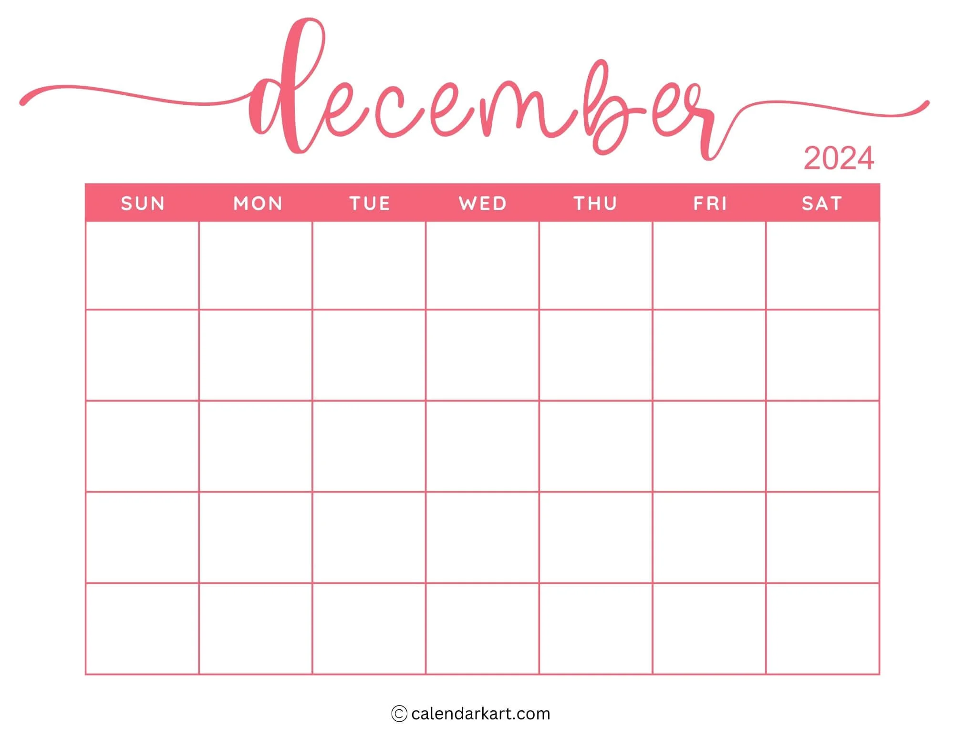


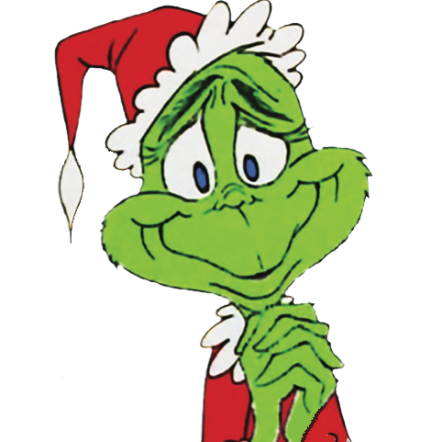
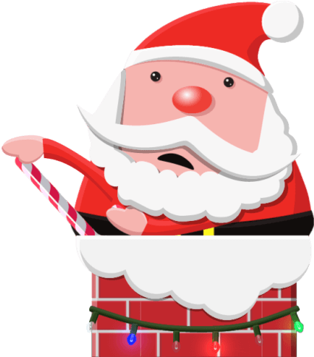
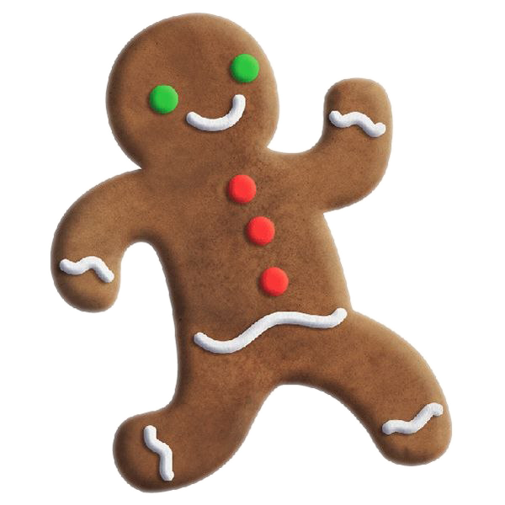

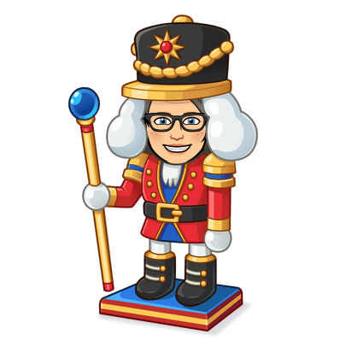
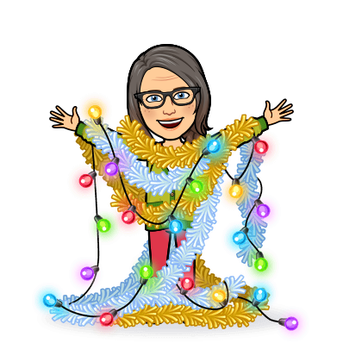


Dates to Remember
in
Dates to Remember in December
I will send the form in Maverick folders on Monday, November 27
(Please return form by Thursday, November 30)
*Holiday Shopping: Dec. 8 11:20-11:50*
*Holiday Party Friday, Dec. 15 10:15-11:45*
Families Welcome!
Dress up Days:
Mid Year
i-Ready
Assessments
Begins
4 Cathedral
Caverns
Field Trip!
1 2 3 5 6 7
Mid Year
DIBELS
Testing
8. 9 10 11 14
12 Holiday
Shopping
1:05-1:35
13
Nutcracker
Field Trip!
17
18
Holiday Party
1:00-2:00
19
1/2 Day
for students
20
1/2 Day
for students
15. 16 PJ Day & 21
22 23 24 25 26 27 28
Winter Holidays!
29
12/23-1/6
Cathedral Caverns Field trip December 4
Your child will need to..
1-Make it to school on time
2-Dress for weather and walking at the Caves
3-Bring a DISPOSABLE lunch packed in a labeled ziploc bag, if you did not pre-order a school sack lunch.
Nutcracker Field Trip December 13
Your child will need to..
1-Make it to school on time
2-Dress to impress! (Sunday/Celebration Clothes)
Holiday Shopping December 12
Your child will need to..
1-Bring Money if you would like for them to shop.
2-Complete the list of gifts to buy and how much to spend.
Holiday Party December 18 1:00-2:00
Parents are welcome to join us!
-Wear PJS!
I will share a sign-up genius for the things we will need to have a great celebration!
I hope you will be able to join us!

Slide 3

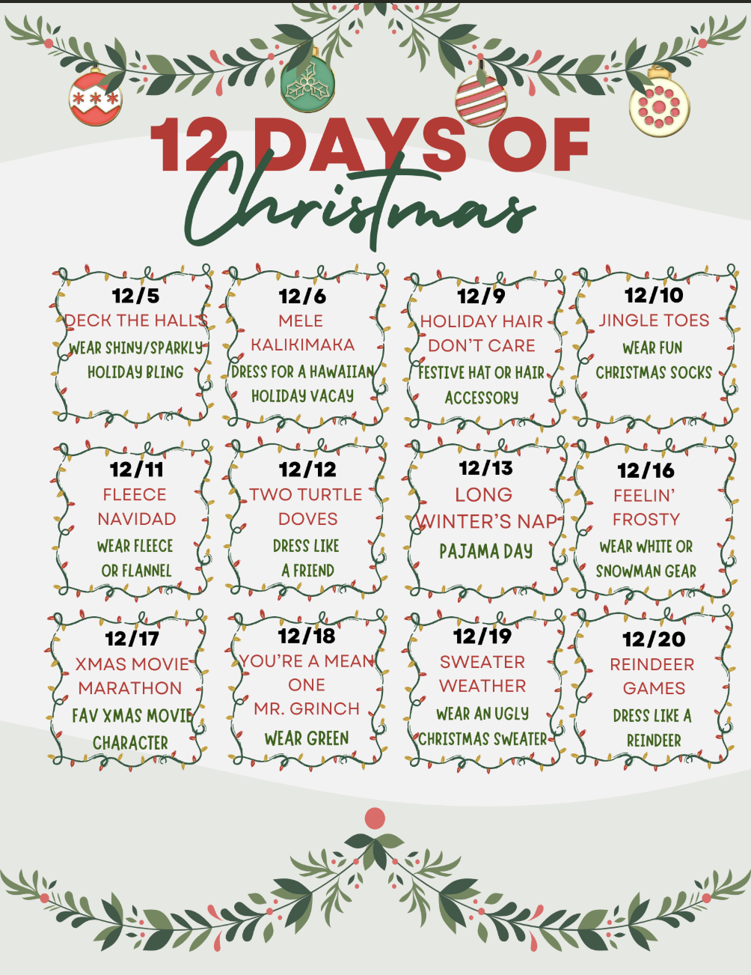

Dates to Remember in December
I will send the form in Maverick folders on Monday, November 27
(Please return form by Thursday, November 30)
*Holiday Shopping: Dec. 8 11:20-11:50*
*Holiday Party Friday, Dec. 15 10:15-11:45*
Families Welcome!
Dress up Days:
at the Mill!
Nutcracker
Dress to Impress!
Wear
PJS!

